Slide 1
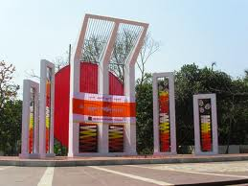
Welcome to the presentation of Cambrian School& College, Dhaka.

Slide 2
International mother language is a day which is observed internationally.21 February is the international mother language day. It is observed all over the world. The then rulers of Pakistan wanted to impose Urdu as our state language. They declared, “Urdu and Urdu shall be the state language of Pakistan.” They did not accept this declaration.

